Slide 1
Paradigms of programming
Grace Victoria sampara
Dept. of metallurgy and materials engineering
20mt10052

Slide 2
Programming Paradigms – a classification based on the features
Imperative
Declarative
The programmer instructs the machine on how to change it’s state.
The programmer declares the properties of the result but not how to compute it.
Procedural
Object Oriented
Functional
Logic
Math
Reactive
groups instructions into procedures
groups instructions with the part of the state they operate on
the result is declared as the answer to a question about a system of facts and rules
the result is declared as the solution of an optimization problem
which the desired result is declared as the value of a series of function applications
The result is declared with data streams and the propagation of change

Slide 3
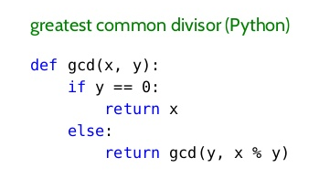
What is Functional Programming?
In layman’s terms FP is a programming paradigm in which mathematical functions are used to write the program
Haskell, Lisp and Python are some examples of programming languages that follow the functional programming paradigm.
FP IS FURTHER CATEGORISED INTO TWO
PURELY FUNCTIONAL
IMPURELY FUNCTIONAL
These types of functional languages support only the functional paradigms.
For example − Haskell.
These types of functional languages support the functional paradigms and imperative style programming.
For example − LISP.

Slide 4
A few important characteristics of functional programming based on Haskell:
IT IS STATICALLY TYPED.
1.Variable types are explicitly declared and thus are determined at compile time.
2.Static typing associates types with variables, not with values.
STATIC TYPING | DYNAMIC TYPING
VARIABLES HAVE A SPECIFIC TYPE AND THAT TYPE CANNOT BE CHANGED. | VARIABLES DO NOT HAVE A SPECIFIC TYPE AND IT CAN BE CHANGED.
String Name; Name= “alpha”; Name=34; | Var Name; Name=alpha; Name=34;

Slide 5
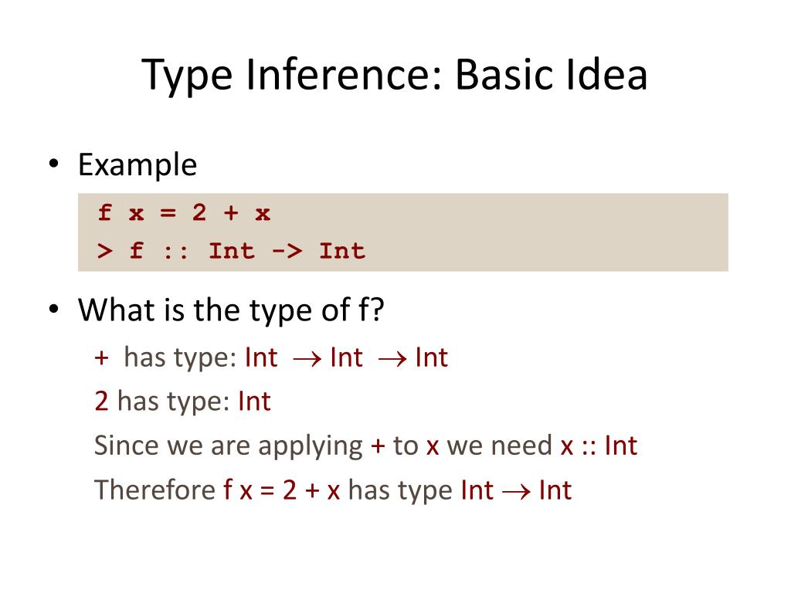
Type inference is the process by which the types for variables and functions, without you needing to specify these types explicitly. Many functional languages feature type inference.
HASKELL is an example .

Slide 6
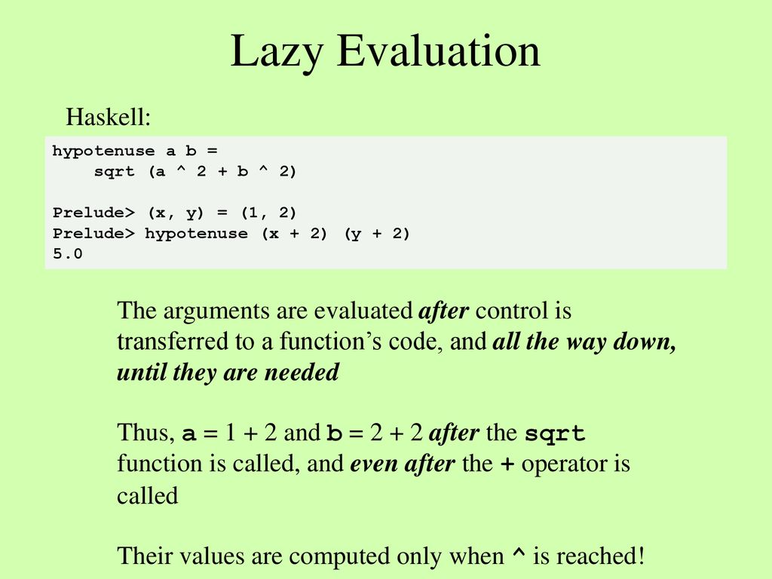
LAZY EVALUATION
It is an evaluation strategy which holds the evaluation of an expression until its value is needed. It avoids repeated evaluation. Haskell is a good example of such a functional programming language whose fundamentals are based on Lazy Evaluation.

Slide 7
PURELY FUNCTIONAL
Every function in Haskell is a function in the mathematical sense . Even side-effecting IO operations are but a description of what to do, produced by pure code. There are no statements or instructions, only expressions which cannot mutate variables (local or global) nor access state like time or random numbers.
The following function takes an integer and returns an integer. By the type it cannot do any side-effects whatsoever, it cannot mutate any of its arguments.
square :: Int -> Int
square x = x * x
The following string concatenation is a type error:
Type error
"Name: " ++ getLine
Because getLine has type IO String and not String, like "Name: " is. So by the type system you cannot mix and match purity with impurity.

Slide 8
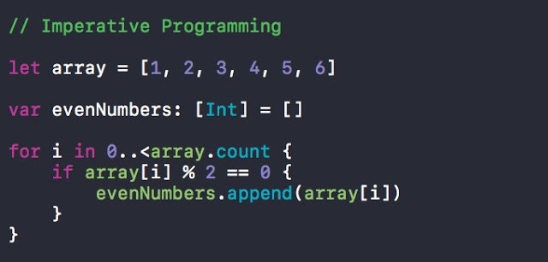
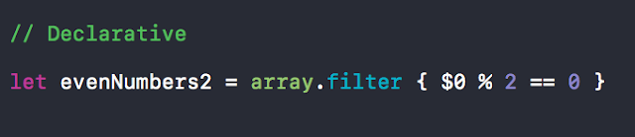
FUNCTIONAL PROGRAMMING | OBJECT ORIENTED PROGRAMMING
BASED ON THE EVALUATION OF FUNCTIONS | BASED ON THE EVALUATION OF OBJECTS
USES IMMUTABLE DATA | USES MUTABLE DATA
FOLLOWS DECLARATIVE PROGRAMMING MODEL i.e. THE PROGRAMMER TELLS THE COMPUTER ‘HOW’ TO ACCOMPLISH A SPECIFIC TASK | FOLLOWS IMPERATIVE PROGRAMMING MODEL i.e. THE PROGRAMMER TELLS THE COMPUTER ‘WHAT’ A PROGRAM SHOULD ACCOMPLISH.
SUPPORTS PARALLEL PROGRAMMING i.e. MANY CALCULATIONS ARE DONE SIMULTANEOULSY. | DOES NOT SUPPORT PARALLEL PROGRAMMING

Slide 9
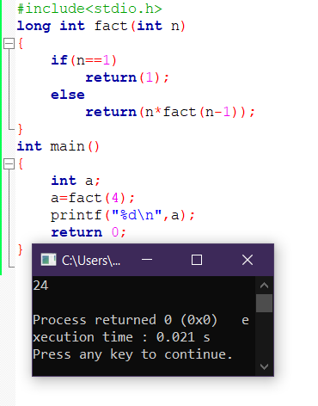
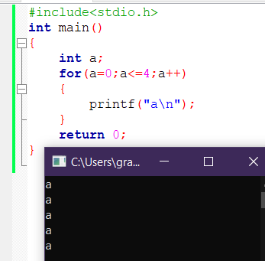
FUNCTIONAL PROGRAMMING | OBJECT ORIENTED PROGRAMMING
THE STATEMENTS IN THE CODE CAN BE EXECUTED IN ANY ORDER | THE STATEMENTS IN THE CODE ARE EXECUTED ONLY IN A PARTICULAR ORDER
RECURSION IS USED FOR ITERATIVE DATA | LOOPS ARE USED FOR ITERATIVE DATA
THE BASIC ELEMENTS OF FP ARE VARIABLES AND FUNCTIONS | THE BASIC ELEMENTS OF OOP ARE METHODS AND CLASSES.

Slide 10
FUNCTIONAL PROGRAMMING IN THE REAL WORLD
Functional Programming is used in situations where we have to perform lots of different operations on the same set of data.
Facebook uses Haskell at scale to fight spam and other types of abuse
2. Messaging apps, including some famous examples like WeChat and WhatsApp, use Erlang to handle insane amounts of concurrent users.
3.Google, Target, Intel, and Microsoft use Haskell.
4.Twitter, Amazon, and Paypal use functional languages like Erlang, Scala, Haskell, and Clojure.

Slide 11
THE MERITS OF FP BASED ON HASKELL:
1.Memory safety.
Manual memory management in C and C++ often leads to buffer overflows, use-after-free, memory leaks, and other memory-related bugs. This results in security vulnerabilities . Software written in Haskell is unlikely to exhibit such issues thanks to automatic memory management.
2.Garbage collection.
There are two ways to achieve memory safety: garbage collection (more common) and static lifetime checking (the Rust way). While garbage collection makes Haskell less suited for real time systems, such as computer games, it is less limiting than lifetime checking, thus facilitating better abstractions and higher developer productivity.

Slide 12
3.Native code.
Unlike Python, Ruby, JavaScript, Lua, and other interpreted languages, Haskell is compiled ahead-of-time, directly to native machine code. The compiler (GHC) is remarkably good at optimization and generating efficient executables. This makes Haskell a great choice for applications that require good performance, such as high-throughput data processing.
4.Metaprogramming.
Haskell supports the inspection and generation of the program’s abstract syntax tree. This feature is called Template Haskell, and it’s used for compile-time evaluation and to automate boilerplate generation.

Slide 13
5.Ecosystem.
Hackage is a centralized repository of open-source Haskell software, featuring over 14000 packages. Stackage is a curated collection of package versions that guarantees compatibility between libraries, featuring over 2000 well-maintained packages. It is not uncommon to find out that the problem you’re solving has already been solved and shipped as an open-source library.

Slide 14
THE DEMERITS OF FP
1. Input/output (IO)
IO relies on side effects, so it’s inherently non-functional. But as it turns out, it’s also crucial to writing a useful application. There are a number of approaches for integrating IO into your application.
2. Recursion
Generally touted as one of the best parts of functional programming, recursion is also very expensive to use. It often utilizes the call stack as a data structure, but it turns out that memory is a valuable resource.

Slide 15
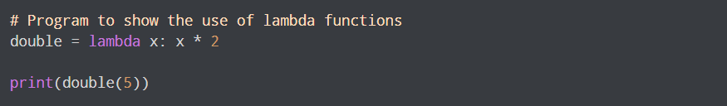
What are lambda functions in Python?
In Python, an anonymous function is a function that is defined without a name.
While normal functions are defined using the def keyword in Python, anonymous functions are defined using the lambda keyword.
Hence, anonymous functions are also called lambda functions.

Slide 16
WHY ARE LAMBA FUNCTIONS USED
Lambda functions are used when you need a function for a short period of time. This is commonly used when you want to pass a function as an argument to higher-order functions, that is, functions that take other functions as their arguments.

Slide 17
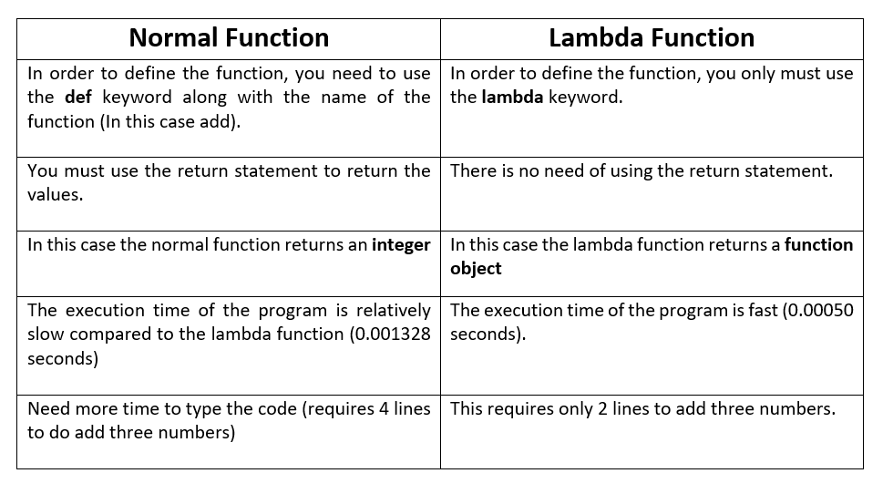

Slide 18
THE END

